Slide 1
Case Study 2 - Exquisite Objects, Prodigious Technique: Aquamanilia, Vessels of the European Middle Ages
Fig. 1012
Fig. 1013
Fig. 15
Aquamanilia are zoomorphic or anthropomorphic vessels that served for the washing of hands at table. Cast from copper alloys, they emerged as a distinct artistic form in the twelfth century in Lower Saxony and continued to be fabricated in various areas of Germany for the next three centuries. They were filled via lidded openings, generally at the tops of the animals or riders’ heads with their spouts either integrally cast as part of the animal's mouth or separately fabricated as a spigot and mechanically set into its chest. They represent an important stage in the evolution of European casting technology, being the first hollow, fully three-dimensional sculptural forms produced since antiquity. Over 300 aquamanilia are known to have survived through the centuries, some inspiring 19th-century replicas, and all are unique forms.
Intro
Context
Lost wax casting
Prep for Casting
Summary of findings...
Synopsis of technical parameters
Further questions
Questions
Core
Wax
Metal
Fettling
Repairs
Chasing
Further Resources
Acknowledgements

Slide 2
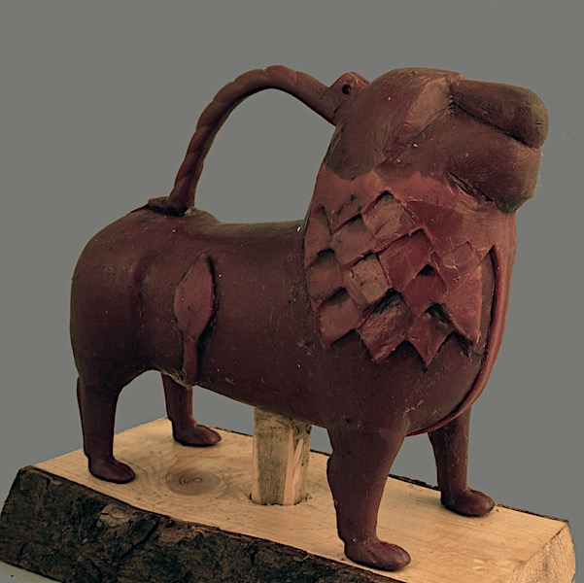
Context for the technical study
Fig. 1012
Fig. 1014
The Metropolitan Museum of Art’s collection of aquamanilia and associated medieval German metalwork became the focus of an exhibition that integrated art historical analyses with the technical examination of the vessels in the Met’s collections and related cast objects in other collections around the world. Several dozen works formed the focal point of this study, though information from many others also fed into this research. Invaluable insights were also gleaned from the experimental replication of one of the Met’s lion aquamanile that followed closely the processes prescribed by the medieval monk Theophilus in his 12th century treatise, On Divers Arts: The Foremost Medieval Treatise on Painting, Glassmaking, and Metalwork. Written around the time when aquamanilia first appeared, the treatise describes, amongst other things, the casting of a complex sculptural censer, a comparable, hollow, copper-alloy object, albeit, cast in two halves.
Intro
Context
Lost wax casting
Prep for Casting
Summary of findings...
Synopsis of technical parameters
Further questions
Questions
Core
Wax
Metal
Fettling
Repairs
Chasing
Further Resources
Acknowledgements

Slide 3
Mane questions
Fig. 1013
The questions/goals for the project were many. They included:
How were these fantastical objects fabricated?
How does their facture compare to the processes outlined in Theophilus’ twelfth century treatise? Might those descriptions help in the interpretation of the technical evidence preserved in such vessels? Do they apply to the fabrication of aquamanile as well?
Ultimately, with data from a large enough sampling pool, would it be possible to start tracing the evolution of this casting technology as the centers of production shifted over time?
Might it be possible to establish idiosyncratic patterns in techniques or materials that would help to identify and characterize the products of particular workshops or regional production centers?
This Case Study will focus predominantly on the first couple of questions.
Intro
Context
Lost wax casting
Prep for Casting
Summary of findings...
Synopsis of technical parameters
Further questions
Questions
Core
Wax
Metal
Fettling
Repairs
Chasing
Further Resources
Acknowledgements

Slide 4
Lost wax casting
Video: V6
All technical evidence points to medieval aquamanilia being cast by the “lost wax” or cire perdue process. This basically entails fashioning a model of the desired form in wax with which to create a hollow impression in a fire-resistant mold material that will serve as a matrix for the liquefied metal. The uniqueness of each known aquamanilia suggests that they were directly modeled over earthen cores. The internal surfaces are all relatively smooth and there are no waxy drip marks or other physical indicators that they would have been formed by an indirect process.
full video of the reconstruction of the Lion aquamanile or diagram of direct casting?
Intro
Context
Lost wax casting
Prep for Casting
Summary of findings...
Synopsis of technical parameters
Further questions
Questions
Core
Wax
Metal
Fettling
Repairs
Chasing
Further Resources
Acknowledgements

Slide 5
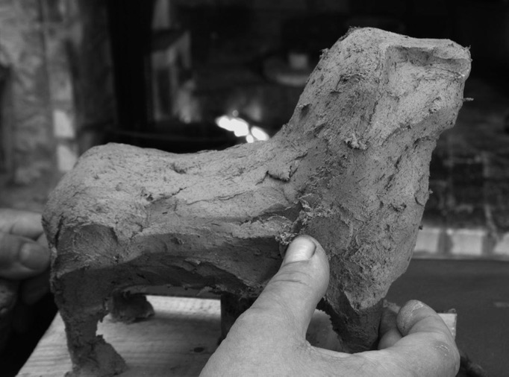
Fabrication: The core (replication)
Fig. 1015
Video: V17
Fig. 1026
Video of core
The internal volume of any hollow bronze is defined by a core made of fire-resistant material. Theophilus describes shaping a well-kneaded and sifted mixture of sandy clay and dried dung into more or less the desired form, integrating many of its physical features. The sand would temper the clay, reducing shrinkage and cracking during firing. The organic material would provide “green” strength or cohesiveness to the mixture and create a more porous body that could help absorb any vapors that might evolve during the pour.
An internal armature would help to support the weight of the clay and evidence for the same was found in the larger and more complex structures.
After casting, the core material and armature are generally removed to clear the hollow of the vessel for use.
Video
Summary of findings...
Synopsis of technical parameters
Intro
Context
Lost wax casting
Core
Wax
Prep for Casting
Metal
Chasing
Further questions
Further Resources
Acknowledgements
Questions
Fettling
Repairs

Slide 6
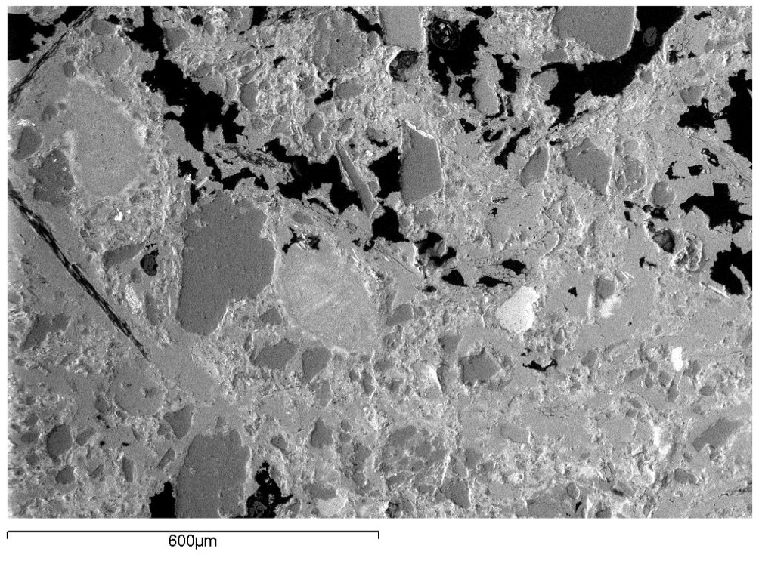
Fabrication Technique: Core (examination)
Fig. 1016
Traces of the earthen mixture preserved in the harder to access areas of several of the aquamanilia were sampled and prepared as thin sections for petrographic analysis and SEM imaging in order to characterize the make-up of the material. Several of more compact examples included the identifiable forms of organic inclusions. The mineral content pointed to metamorphic rock source, but overall these analyses were inconclusive as yet regarding the identification of the clays’ geological origin, and therefore geographical location of the aquamanilias’ production.
Video
Summary of findings...
Synopsis of technical parameters
Intro
Context
Lost wax casting
Core
Wax
Prep for Casting
Metal
Chasing
Further questions
Further Resources
Acknowledgements
Questions
Fettling
Repairs

Slide 7
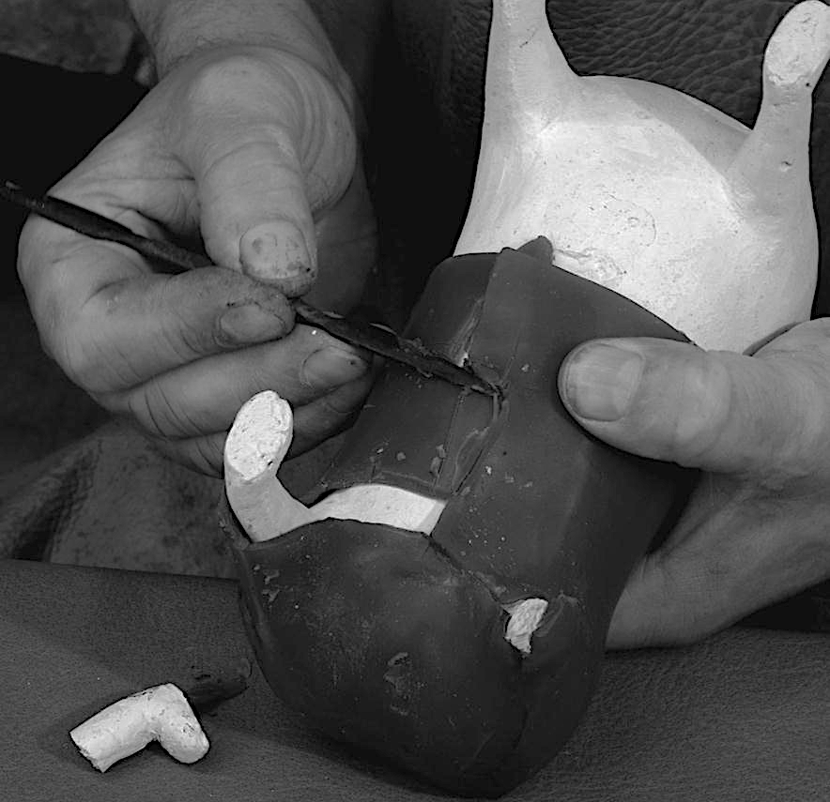
Fabrication Technique: Wax layer (replication)
Video: V16
Fig. 1027
Fig. 1014
Video of wax
The model for the censer as Theophilus describes it, was created by overlaying the cured core with pieces of sheet wax rolled out to a specific depth, cut into “small pieces according to the spaces which you have cut in the clay of the censer,” warmed, and applied with the aid of a hot iron, then trimmed and smoothed out taking care that the thickness of the wax layer was “not thicker or thinner in one place than another.” Such evenness helps to ensure that the metal cools and shrinks at an even rate, avoiding distortions. The fine modeling of details can then begin. This same process was applied to the replication of the Lion aquamanile.
Intro
Context
Lost wax casting
Prep for Casting
Summary of findings...
Synopsis of technical parameters
Further questions
Questions
Core
Wax
Metal
Fettling
Repairs
Chasing
Further Resources
Acknowledgements

Slide 8
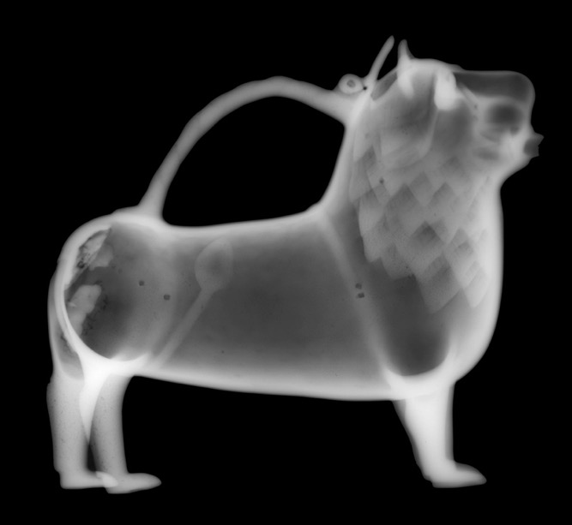
Fabrication : Wax model (examination 1)
The physical evidence points to the aquamanilia being directly modeled in wax as described by the monk. The many fine details have the quality of a malleable material, and many are ultimately added in the wax sheet. In some instances, elements such as the sculptural handles would have been formed separately and then joined to the body of the vessel.
Radiographs were invaluable in assessing the overall form of an aquamanilia’s core and how the wax layer (translated into metal) was built up. In such images, the denser, more x-ray opaque materials show up whiter. The consistent opacity observed in the central part of both lions’ bodies points to their modeling in a single layer of sheet wax. The slimmer parts of the legs modeled in solid wax.
In the X-ray of the lion on the left, the details of the mane are denser, showing that they were built up with additional triangles of wax. The undulating shapes of the mane in the lion on the right, in contrast, were already formed in the core and overlaid by an even layer of wax s prescribed. The darker areas in this second lion’s mane may have occurred while pressing the wax sheet onto the more complex core shapes, or from revisions in the final modeling that might have thinned the wax and resultant metal cast.
Intro
Context
Lost wax casting
Prep for Casting
Summary of findings...
Synopsis of technical parameters
Further questions
Fig. 1018
Fig. 1017
Questions
Core
Wax
Metal
Fettling
Repairs
Chasing
Further Resources
Acknowledgements

Slide 9
Fabrication : Wax model (examination 2)
Fig. 1021
Fig. 1019
Fig. 1020
The more complex and larger aquamanilia required a more sophisticated structure, which could signify separately-modeled figures (and cores), and/or the additional support of localized armatures. The core of the Falconer, for instance, appears from the radiographs, to be continuous with that of the horse. The slightly darker shape in the hollow suggests that it preserves the less dense impression left by an organic armature. Conversely, the x-ray image of the small Samson wrestling on the back of the lion shows that the core of the human figurine extended only to his knees and shoulders: Samson was modeled in wax separately before being joined to the back of the wax lion. A fine wire armature can be detected coming down from his neck to his belly area.
Theophilus does not refer to armatures as the openwork form of the censer and the bell-like shape of its two halves had sufficient surface area for the cohesion of the "investment" to not require the use of armatures, but fine wires and other materials were certainly used. Again, these are often removed from the body of the vessel after casting, but may be left in other areas.
Fig. 1022
Intro
Context
Lost wax casting
Prep for Casting
Summary of findings...
Synopsis of technical parameters
Further questions
Questions
Core
Wax
Metal
Fettling
Repairs
Chasing
Further Resources
Acknowledgements

Slide 10
Fabrication – Core pins, sprueing and investing (replication)
V19
Fig. 1023
Fig. 1024
Once the modeling was complete, metal core pins were partially inserted through the wax and into the core to secure the registration of the aquamanilia’s cores within their outer mold or “investment.” [video showing insertion of core pins]
Next, the model would be fitted with a network of sprues through which to melt out the wax, feed the liquefied metal in the mold, and allow the gas and air to escape. When possible, connections helping with that flow were integrated into the design of the sculptural form itself, as can be seen in the Falconer.
Then, as Theophilus describes, multiple layers of earthen mold material (similar to that of the core) were gradually built up over the sprued wax model. This clay investment mold containing the sprued model would be heated to melt out the wax, which, being an expensive material would, according to the treatise, be recovered and presumably recycled. Heating the mold would also serve to get rid of all moisture because, the monk warns, “if the inside cores experience dampness, they immediately swell and all your work will break apart.” The mold is then heated until it is red hot and buried in a pit, casting cup up, ready to receive the liquefied metal which is poured from a crucible in which it has, meanwhile, been alloyed.
Video pf core pins through casting
Intro
Context
Lost wax casting
Prep for Casting
Summary of findings...
Synopsis of technical parameters
Further questions
Questions
Core
Wax
Metal
Fettling
Repairs
Chasing
Further Resources
Acknowledgements

Slide 11
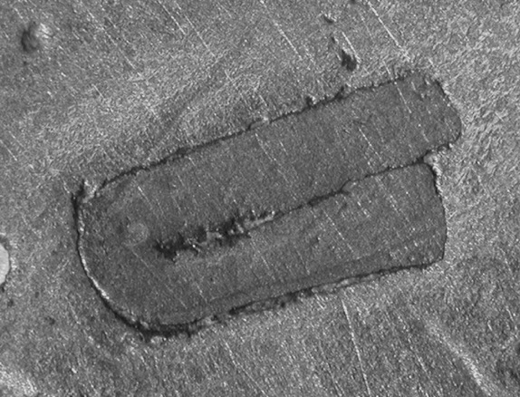
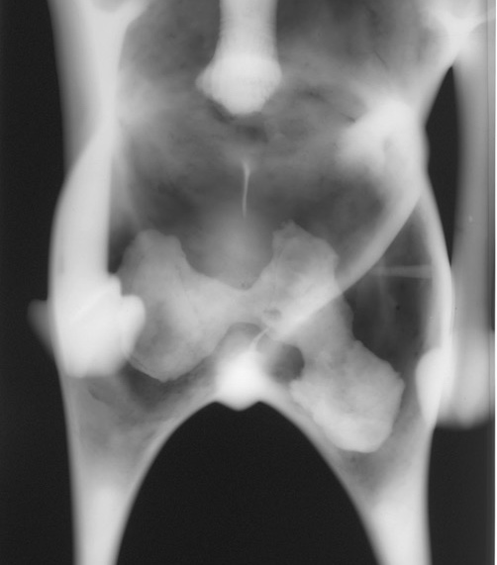
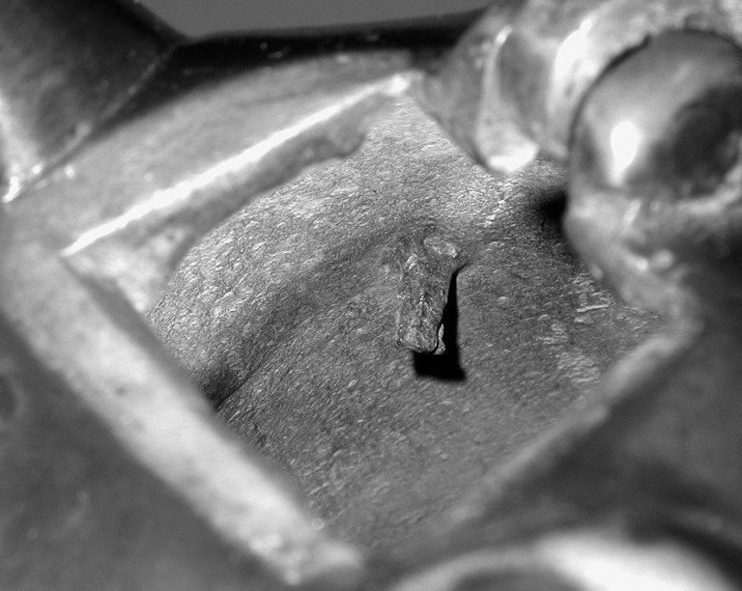
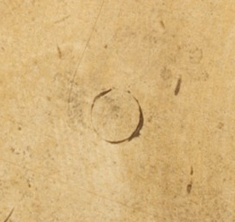
Fig. 1028
Fig. 1029
Fabrication: Core pins and core plugs (examination)
Examination of the aquamanilia revealed that these were made of iron or copper – some out of bent copper sheet. The use of one type did not preclude the other. Should the core pins fuse to the metal during casting they were cut down to the level of the outer surface and smoothed over with some surrounding metal. But the internal portion is often still preserved on the inside, and visible in radiographs or in accessible areas. If they could be loosened, however, the core pins were removed and the ensuing hole filled with a core plug, which was often a tapering copper pin hammered in.
Patterns may be found in the treatment of core pins and may prove characteristic of a workshop. In the Nuremberg aquamanilia studied here, all core pins were removed, the ensuing holes rounded with files and plugged with shallow discs of metal similar to the cast (probably cut from a sprue), and their joins secured with soft solder.
Fig. 1025
Fig. 1030
Fig. 1031
Intro
Context
Lost wax casting
Prep for Casting
Summary of findings...
Synopsis of technical parameters
Further questions
Questions
Core
Wax
Metal
Fettling
Repairs
Chasing
Further Resources
Acknowledgements

Slide 12
Fabrication: Metal
Theophilus describes coloring copper by the cementation process using “a stone of yellowish color, sometimes reddish.” This stone was, in fact, the zinc ore calamine and the process that of alloying “latten,” a brassy metal containing Zn as the primary alloying agent and Sn and Pb in levels above 1%. (Zinc as a metal had not yet been isolated or identified in his time.) This is the golden-colored metal predominantly used for aquamanilia. Workshops in northern Germany and Lower Saxony, and later in Nuremburg were close to the source of these raw materials.
Each ore source has distinctive trace minerals, which can help to identify where the metal comes from. To what extent the tin and lead contents were intentional cannot be readily determined as both were also contained in copper ores. And given that metals were often recycled, with each remelting, the zinc concentration might be reduced due to the evaporation of zinc vapor. With so many variables to consider and a relatively small statistical group to work from, the results to date of the metal analysis are far from conclusive.
That said, over the span of production of aquamanilia, the techniques used to alloy the calamine with copper became more sophisticated, which allowed for an enhanced absorption of zinc. Such an increase can be seen in the alloy analysis of aquamanile produced in Nuremberg at the beginning of the 15th century when compared to that of earlier casts.
Fig. 1046
Intro
Context
Lost wax casting
Prep for Casting
Summary of findings...
Synopsis of technical parameters
Further questions
Questions
Core
Wax
Metal
Fettling
Repairs
Chasing
Further Resources
Acknowledgements

Slide 13
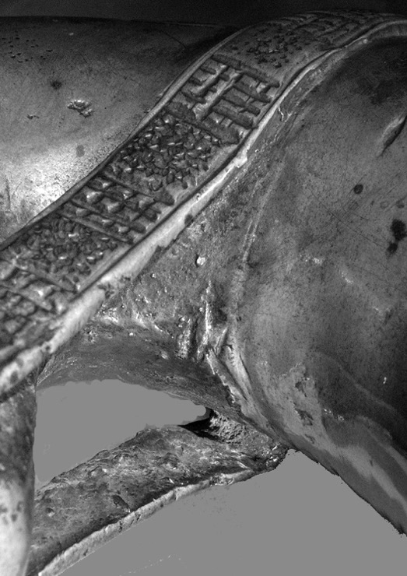
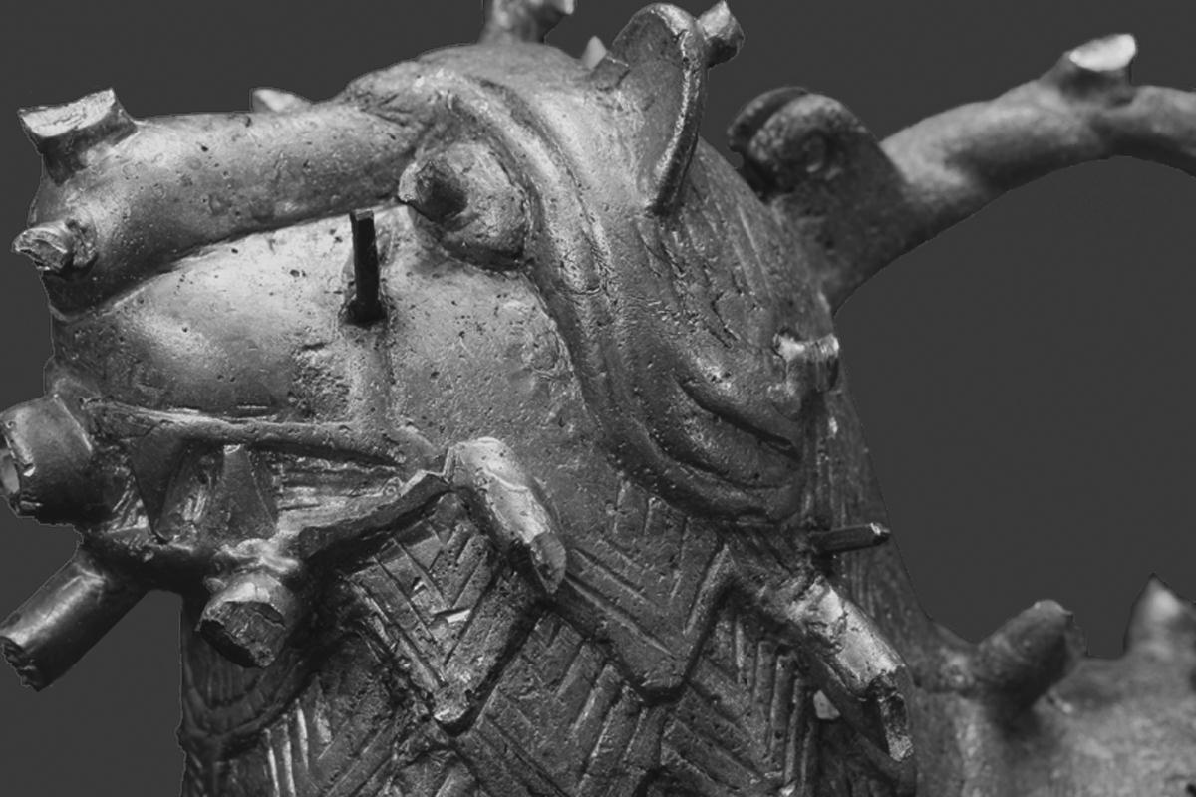
Fabrication: Fettling
Fig. 22
Fig. 1033
Once the metal had cooled in the mold, the investment was broken away to reveal the casting. Fettling was the initial step in finishing the raw casting with the retained sprueing system - runners and risers - and core pins cut back with chisels and files. Once these features were removed, the artist had greater access to the as-cast surface, which in medieval western Europe were generally coarse and required significant finishing. One can get a better sense of these in areas inaccessible to tooling, like the undersides of handles, or animals’ indented paws or hooves.
Intro
Context
Lost wax casting
Prep for Casting
Summary of findings...
Synopsis of technical parameters
Further questions
Questions
Core
Wax
Metal
Fettling
Repairs
Chasing
Further Resources
Acknowledgements
Video

Slide 14
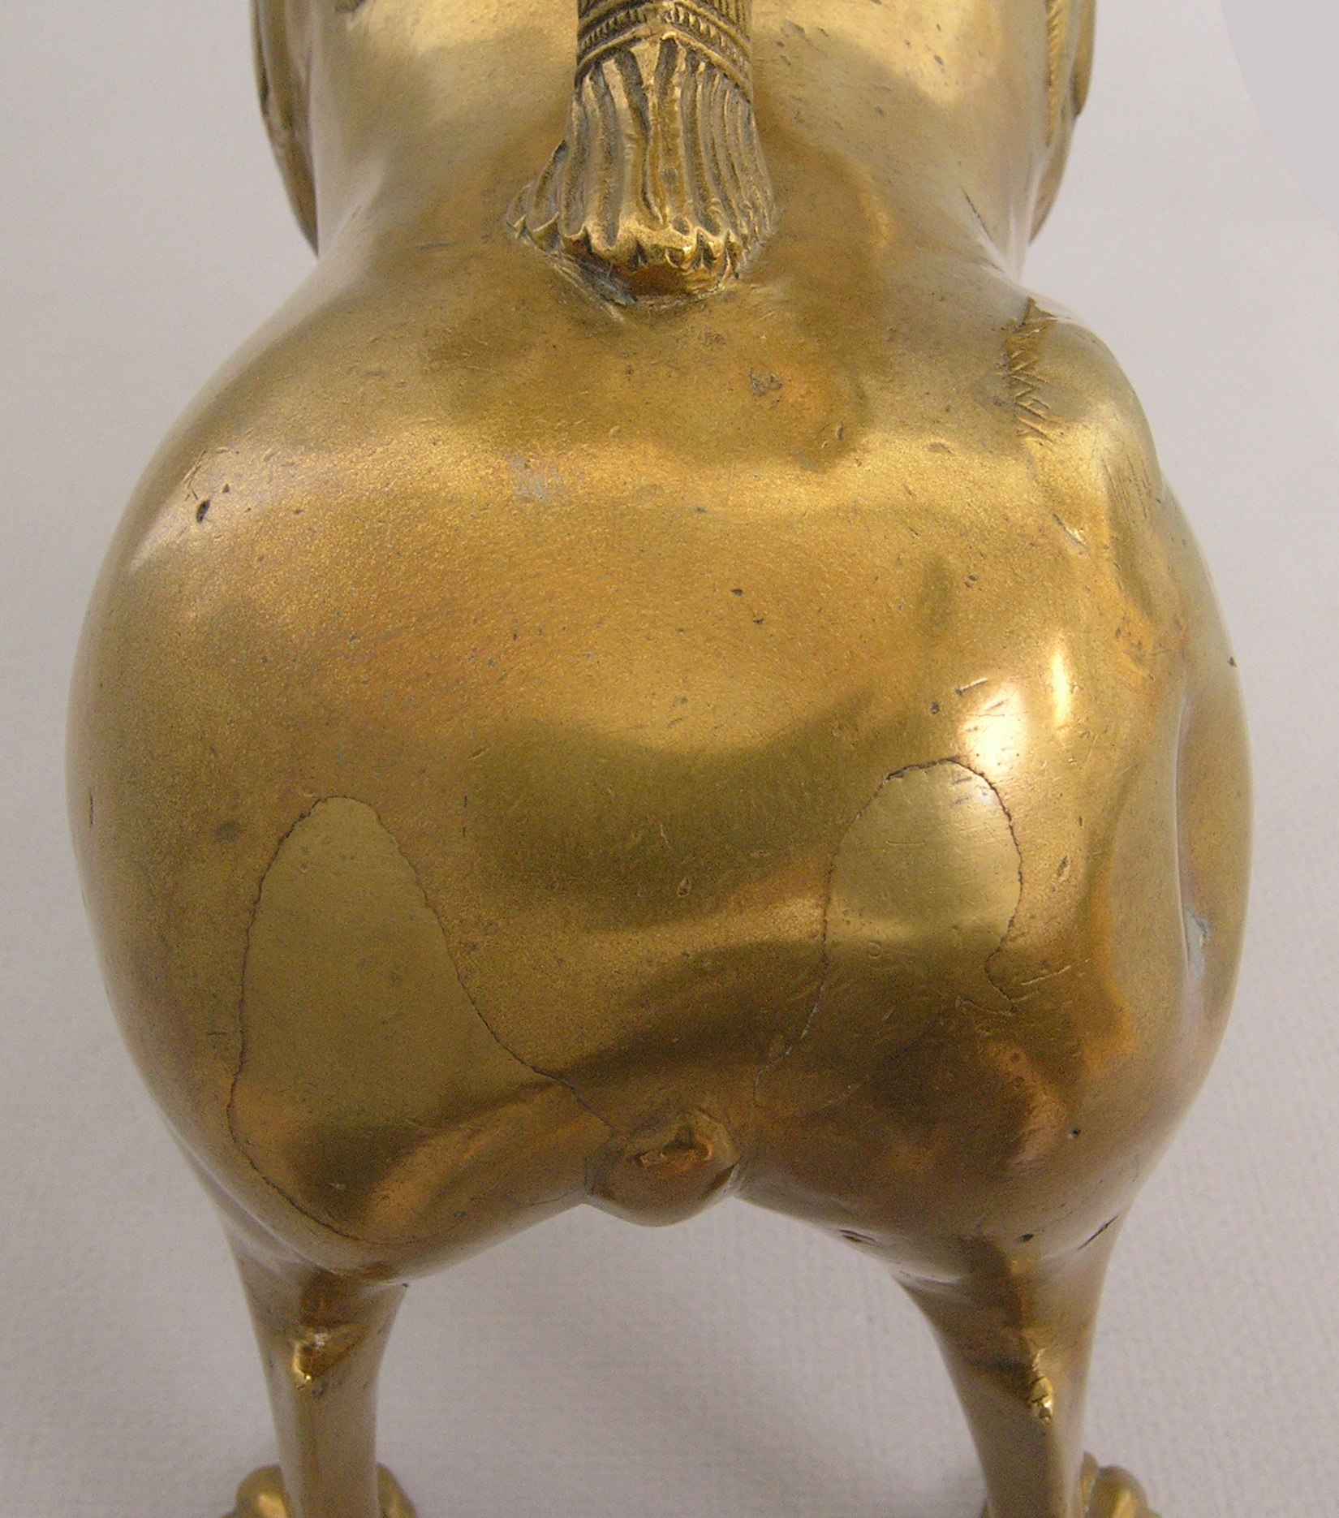
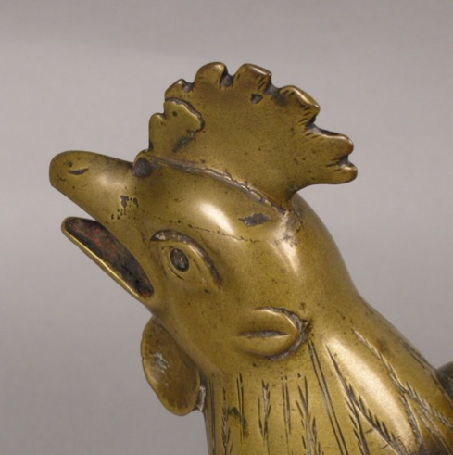
Fig. 1035
Fig. 1025
Fabrication: Cast-in repairs
Fig. 1034
Imperfections and casting flaws seemed to have been an anticipated outcome for medieval metalworkers. And the replication experiment ended up with a few as well. Theophilus suggests using a localized lost-wax process for making repairs. “[I]f there is any flaw, due to neglect or accident, [...] thin out that place by filing around it. Apply wax and likewise add clay on top and when it is dry, heat it, and so pour over it until the liquid bronze flows into that place and what you have poured on top adheres. If, when you examine it, it is not strong enough, solder with burnt wine-tone and the filings of mixed silver and copper as we have described above.”
Many of the aquamanilia showed evidence of such “cast-in” repairs. The join lines are generally faint on the outer surface, but when used, the silver-gray solder is visible. And denser masses of metal that flowed into the hollowed core area are clearly defined in the X-rays.
Intro
Context
Lost wax casting
Prep for Casting
Summary of findings...
Synopsis of technical parameters
Further questions
Questions
Core
Wax
Metal
Fettling
Repairs
Chasing
Further Resources
Acknowledgements

Slide 15
Fabrication: Patches and plugs
Fig. 1036
Fig. 1018
Round core plugs
Hammered-in copper-alloy plugs or patches were used on smaller flaws, and some of these were reinforced with solder as well. In late 14th-century aquamanilia from Nuremberg, all of the pins were removed after casting and the holes in the metal skin filed to receive a round plug that was a similar color to the body, so probably using metal cut from a sprue.
Intro
Context
Lost wax casting
Prep for Casting
Summary of findings...
Synopsis of technical parameters
Further questions
Questions
Core
Wax
Metal
Fettling
Repairs
Chasing
Further Resources
Acknowledgements

Slide 16
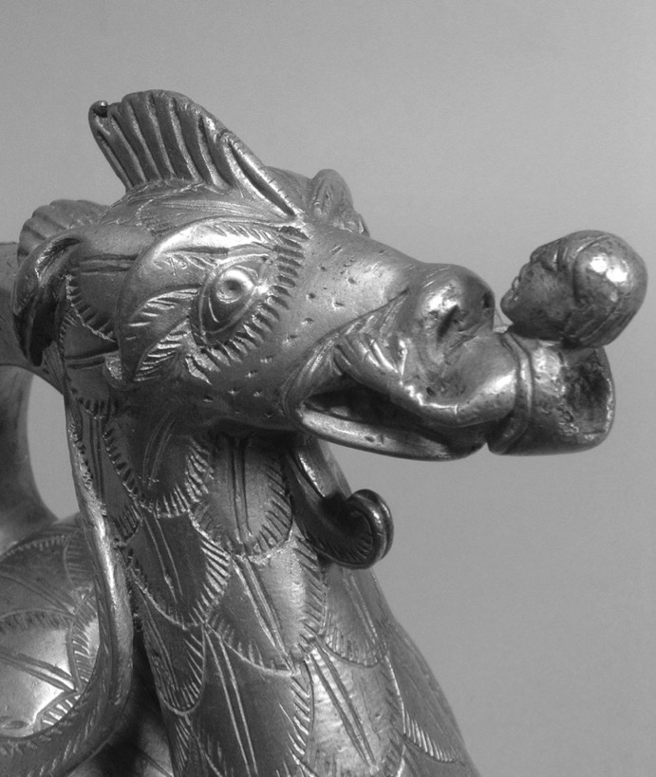
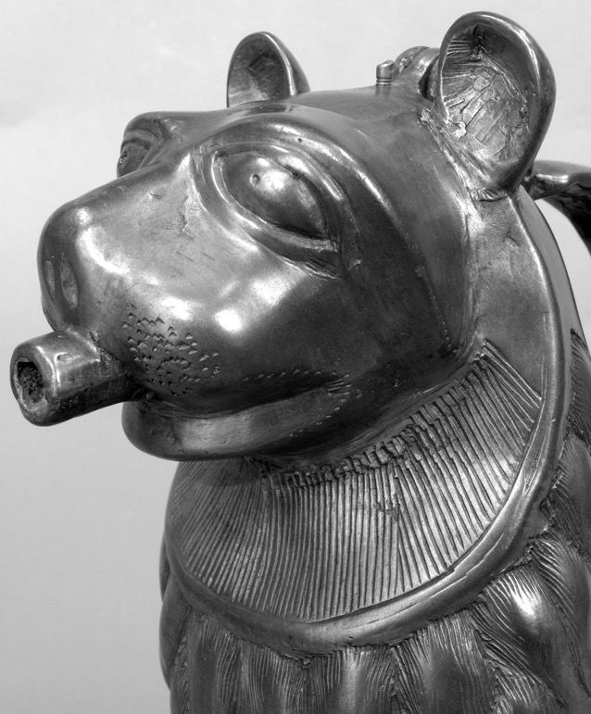
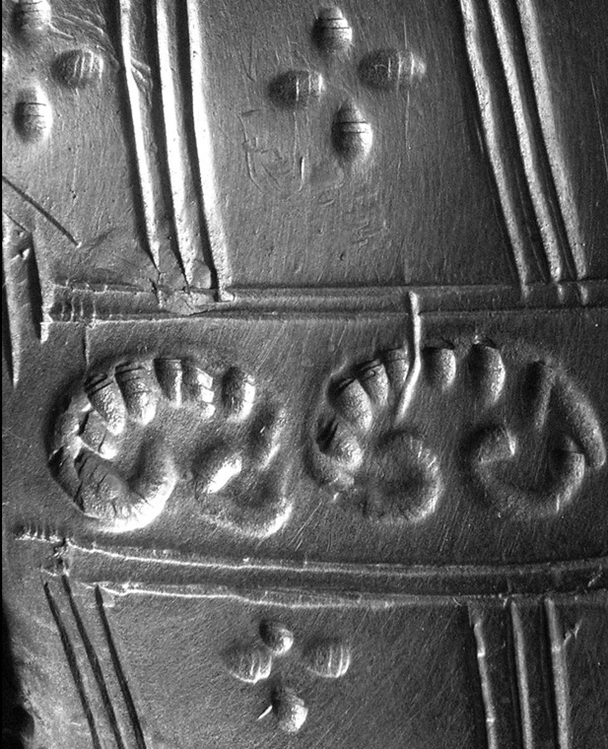
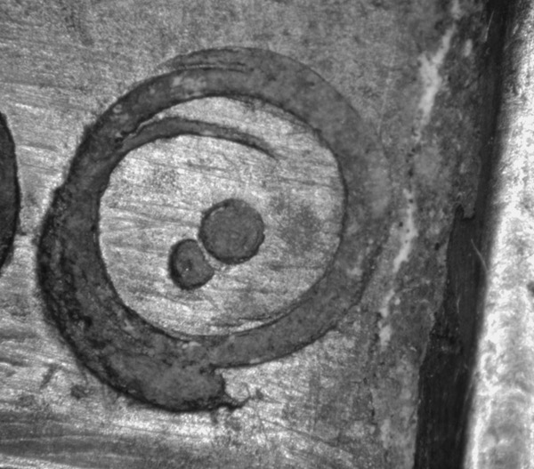
Fig. 1038
Fig. 1039
Fig. 1040
Fabrication: Chasing
V21
Video of chasing
Chasing required the use of a variety of tools to reduce marks from fettling, close-up surface porosity and small blemishes, and reinforce or even introduce decorative details. While the vessels’ surfaces have been worn by use over the centuries, they still preserve many clear marks of the tools used, including files, claw chisels, punches, scrapers, drills, burnishers and abrasives. And there is a definite echo of Theophilus’ prescription that “you first file over all the grounds with various files [...] then engrave with the engraving tools and scrape with scrapers. Finally, [...] clean [...] all over with sand and with sticks slightly rushed at the top [...].” A couple of the aquaminilia’s eyes are further embellished with inlaid colored glass pupils. Few of the vessels, however, were gilded.
Fig. 1041
Fig. 1042
Intro
Context
Lost wax casting
Prep for Casting
Summary of findings...
Synopsis of technical parameters
Further questions
Questions
Core
Wax
Metal
Fettling
Repairs
Chasing
Further Resources
Acknowledgements

Slide 17
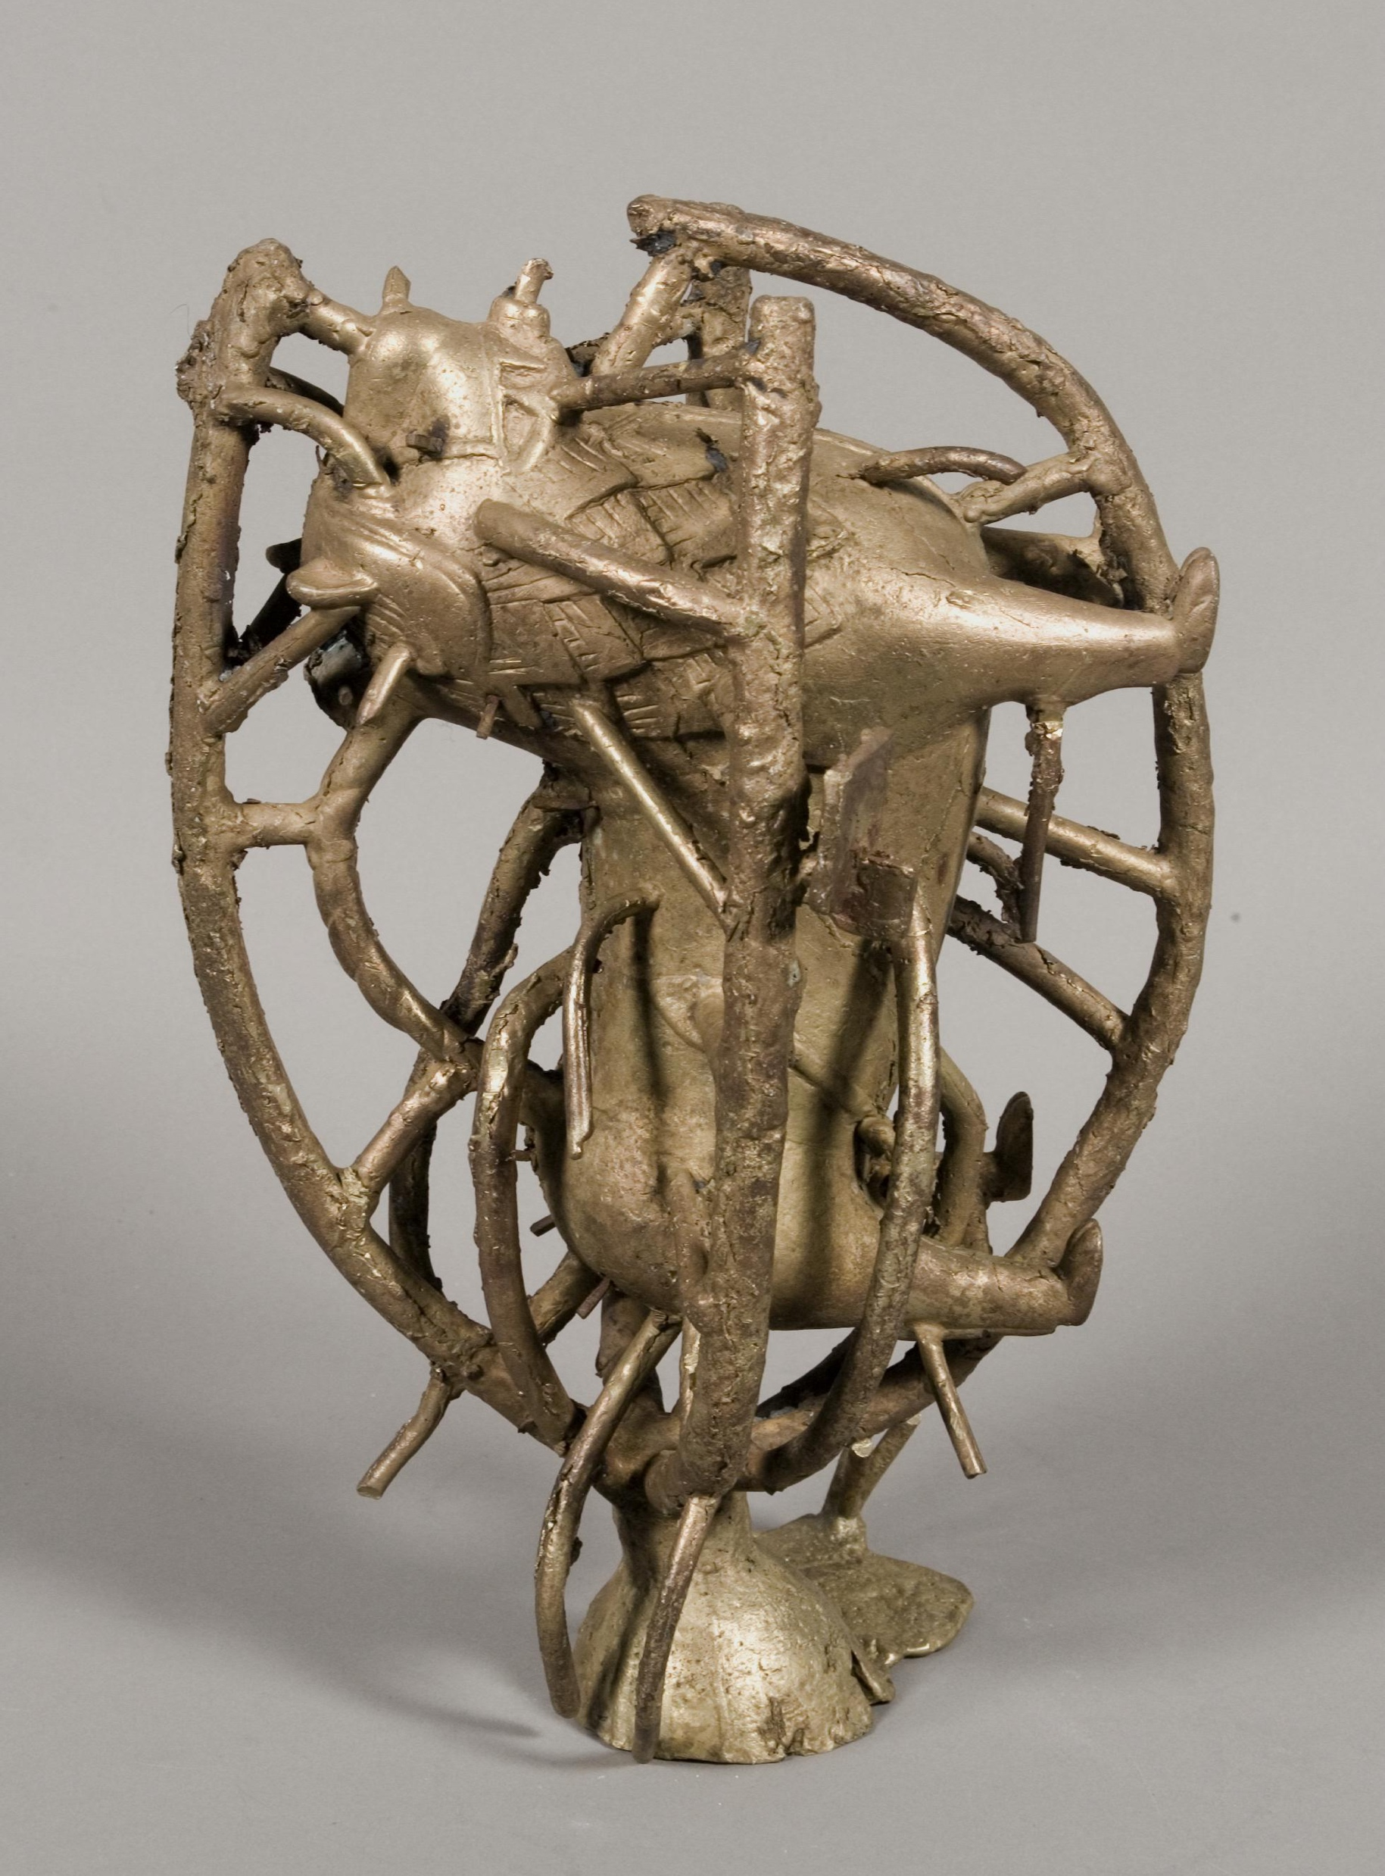
Summary of Findings
Fig. 1043
The physical evidence encountered during the technical study of the representative grouping of aquamanilia and a few related objects in this study finds great resonance with Theophilus’s description of the casting of a censer in his treatise On diverse arts.
While recognizing the challenges of producing a truly “authentic” reproduction of a historical process, by adopting as closely as possible the practices and materials described in Theophilus’s treatise, the experimental reproduction of one of the Met’s lion aquamanilia provided a more nuanced appreciation of the technical parameters of the originals, down to the recreation of an unintended casting flaw.
Techniques and materials used in casting aquamanile remained fairly consistent over the course of their creation, but as their forms became more complex, adaptations were made. And some regional variants in methodology were noted. For instance, in addition to the idiosyncratic core plugs, the aquamanilia cast in Nuremberg sported separately cast spigots, and the brass alloy used was consistently high in zinc.
Intro
Context
Lost wax casting
Prep for Casting
Summary of findings...
Synopsis of technical parameters
Further questions
Questions
Core
Wax
Metal
Fettling
Repairs
Chasing
Further Resources
Acknowledgements

Slide 18
Synopsis of Technical Study Parameters
The research was undertaken in collaboration with the Bard Graduate Center for Studies in the Decorative Arts, Design, and Culture and culminated in an exhibition in New York city at the Bard Graduate Center accompanied by a catalogue: Lions, Dragons, and Other Beasts: Aquamanilia of the Middle Ages, Vessels for Church and Table, eds. Peter Barnet and Pete Dandridge, New Haven, Conn., and London: Yale University Press, for the Bard Graduate Center for Studies in the Decorative Arts, Design, and Culture and the Metropolitan Museum of Art, 2006.
The multiple aspects of the technical examination were conducted as part of the day-to-day responsibilities of the Objects Conservation Department at The Metropolitan Museum. While no specific log was kept of time spent, the research, associated teaching, travel and writing represented the better part of two year’s work. Unless otherwise stated, the examination and analysis was undertaken at The Met.
Endoscopic and microscopic examination of interior and exterior surfaces.
Visible light photography of exterior and interior surfaces.
Surface analyses by qualitative X-ray fluorescence (XRF) analysis of disparate elements incorporated either at the time of manufacture or as part of a later restoration.
X-radiography
Scanning electron microscopy and polarized light microscopy of core and investment material
X-ray diffraction (XRD) analyses of discrete samples of the polishing compounds and pigments.
Inductively coupled plasma-Mass spectrometry (ICP-MS) analysis of metal samples, The Rathgen-Forschungslabor, Berlin.
Replication casting, Ubaldo Vitali
Video documentation and editing, Bard Graduate Center for Studies in the Decorative Arts, Design, and Culture
Intro
Context
Lost wax casting
Prep for Casting
Summary of findings...
Synopsis of technical parameters
Further questions
Questions
Core
Wax
Metal
Fettling
Repairs
Chasing
Further Resources
Acknowledgements

Slide 19
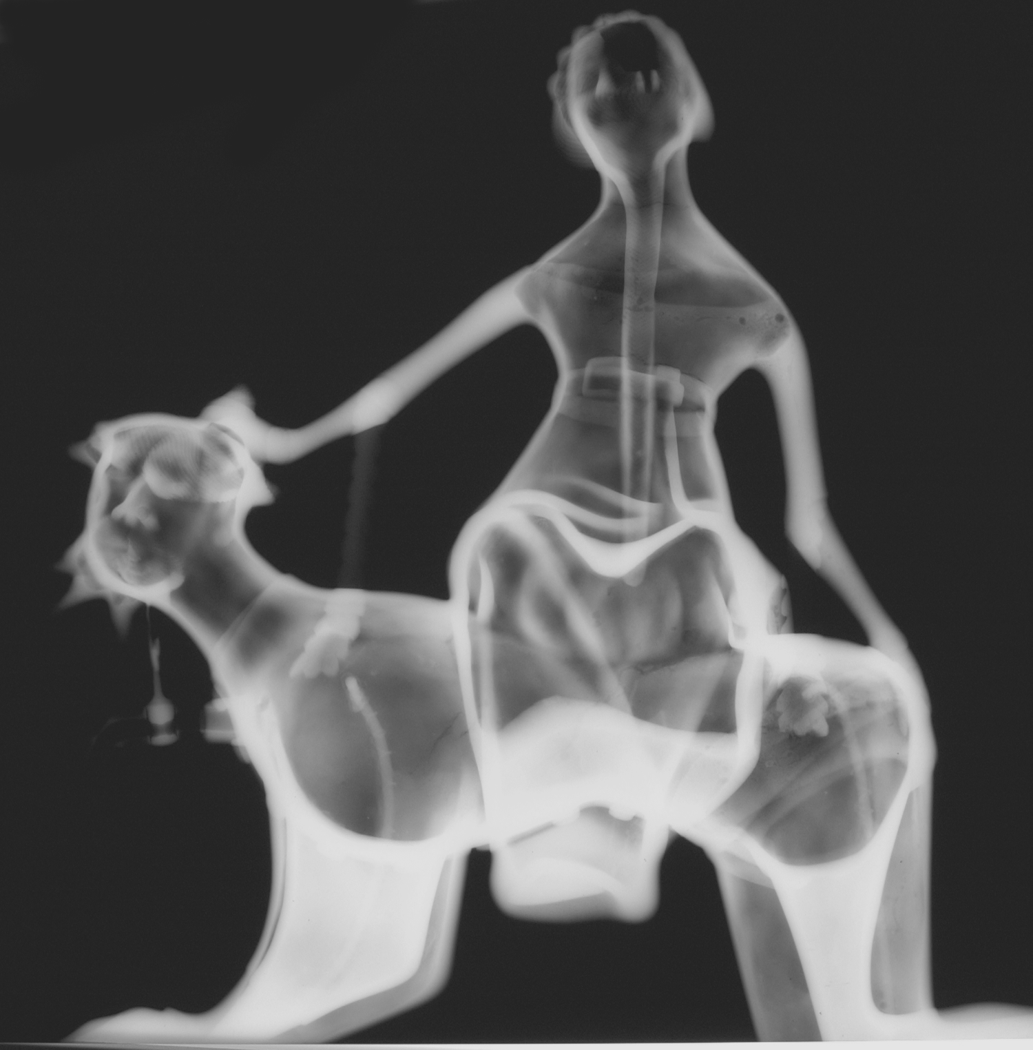
Future Questions
Fig. 1044
Many aquamanile and other cast medieval objects examined in European collections retain significantly more core material than the corresponding material in American collections. What might we learn from the analysis of a broader selection of core samples? Might further analysis corroborate some of the groupings made on stylistic grounds? Are there detailed enough geological maps of Germany to allow for the identification of geologic sources for the materials comprising their clays. And what additional information might be gleaned from the shape and size of the component grains?
What technical relationships might we find between aquamanilia, other small-scale cast objects, and monumental works of art from the same period?
Intro
Context
Lost wax casting
Prep for Casting
Summary of findings...
Synopsis of technical parameters
Further questions
Questions
Core
Wax
Metal
Fettling
Repairs
Chasing
Further Resources
Acknowledgements

Slide 20
Further Resources
Bourgarit, D. and Thomas N. 2015. “Ancient brasses: misconceptions and new insights”, in Archaeometallurgy in Europe III, Der Anschnitt, 26, Bochum, pp. 255-261.
Cellini, B. (Ashbee) 1967. The Treatises of Benvenuto Cellini on Goldsmithing and Sculpture, transl. C. R. Ashbee, New York.
Dandridge, P. 2018. “The Hildesheim Baptismal Font: A window into Medieval workshop practices,” in Thomas, N. and Dandridge, P. eds., Cuivre, bronzes et laitons médiévaux : Histoire, archéologie et archéométrie des productions en laiton, bronze et autres alliages à base de cuivre dans l’Europe médiévale (12e-16e siècles). Medieval copper, bronze and brass: History, archaeology and archaeometry of the production of brass, bronze and other copper alloy objects in medieval Europe (12th-16th centuries), [Actes du colloque de Dinant et Namur, 15-17 mai 2014. Proceedings of the symposium of Dinant and Namur, 15-17 May 2014], Namur.
Barnet, P. and Dandridge P. eds. 2006. Lions, Dragons, and Other Beasts: Aquamanilia of the Middle Ages, Vessels for Church and Table, New Haven, Conn., and London.
(The DVD Vitali, U. and Dandridge, P. Medieval Alchemy and the Making of a Lion Aquamanile, ed. Han Vu. documenting the replication of a Lion aquamanile was included as an insert in the catalogue. The DVD is accessible on this site under videos.)
Magnus, A. 1967. Book of Minerals, transl. D. Wyckoff, Oxford.
Mende, U. 2013. Die mittelalterliche Bronzen im Germanischen Nationalmuseum. Bestandskataloge des Germanischen Nationalmuseums, Nürnberg.
Theophilus (Hawthorne, J. G. and Smith C. S. eds. )1979. On Divers Arts: The Foremost Medieval Treatise on Painting, Glassmaking, and Metalwork, New York.
Intro
Context
Lost wax casting
Prep for Casting
Summary of findings...
Synopsis of technical parameters
Further questions
Questions
Core
Wax
Metal
Fettling
Repairs
Chasing
Further Resources
Acknowledgements

Slide 21
Acknowledgements
Fig. 1045
Peter Barnet, Michel David-Weill Curator in Charge of the Department of Medieval Art and The Cloisters.
James H. Franz, Senior Research Scientist, Department of Scientific Research, The Metropolitan Museum of Art.
Ubaldo Vitali
Han Vu, the Bard Graduate Center for Studies in the Decorative Arts, Design, and Culture.
Richard Newman, Senior Research Scientist, Scientific Research Lab, Museum of Fine Arts, Boston.
Dr. Josef Riederer, The Rathgen-Forschungslabor, Berlin.
Intro
Context
Lost wax casting
Prep for Casting
Summary of findings...
Synopsis of technical parameters
Further questions
Questions
Core
Wax
Metal
Fettling
Repairs
Chasing
Further Resources
Acknowledgements

